Slide 1
CSCI561 Fall 2018 Week 12 Discussion
Prof Sheila Tejada
Prof Wei-min shen
Prof Ning wang
cs561-l@mymaillists.usc.edu
Prof Sheila Tejada stejada@usc.edu
Prof Wei-min Shen shen@isi.edu
Prof Ning Wang nwang@ict.usc.edu

Slide 5
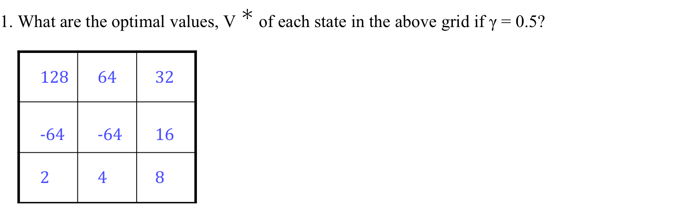
MDP
What are the optimal values and policy?

Slide 6
MDP
2. What are the Q-values for the last square on the second row (i.e., the one without fire)?
Q((1, 2), N) = 16
Q((1, 2), W) = −32
Q((1, 2), S) = 4

Slide 7
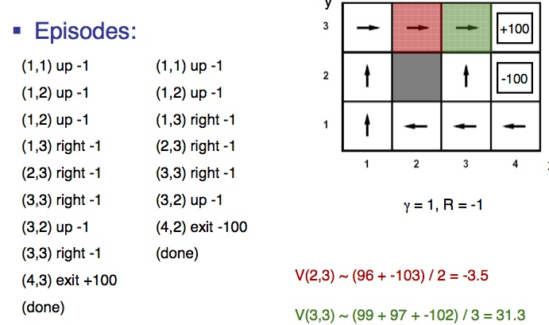
Q-Learning
Q(s,a)← (1-⍺)Q(s,a) + ⍺(R(s)
+ 𝛾 max_{a’}Q(s’,a’))
Example 1
(1,1) up 0
(1,2) up 0
(1,3) right 0
(2,3) right 0
(3,3) right 0
(4,3) exit 100
(done)
Example 2
(1,1) up 0
(1,2) up 0
(1,3) right 0
(2,3) right 0
(3,3) right 0
(4,3) exit 100
(done)
Example 3
(1,1) up 0
(1,2) up 0
(1,3) right 0
(2,3) right 0
(3,3) right 0
(3,2) up 0
(4,2) exit -100
(done)
α=.5 γ = .5 R=0
After E1
Q((2,3),R) = 0 Q((3,3),R) = 0
After E2
Q((2,3),R) = 0 Q((3,3),R) = 25
After E3
Q((2,3),R) =6.25 Q((3,3),R) = 12.5

